Slide 1


Formative Assessment Strategy: Thinking Beyond the Paper-Pencil Test
Core Advocates Monthly Webinar
September 4, 2019
The webinar will begin shortly.
Check your Resource widget to preview the resources for today’s session! Use the Group Chat to introduce yourself!
Notes:
First timer poll
Handouts:
While we’re waiting, we’d like you to participate in a quick poll so we can get an understanding of who’s on the webinar with us tonight.

Slide 2

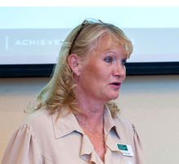


Introductions
Your hosts from the Tools and Classroom Resources Team
Claire Rivero -- Digital Strategy Manager
Laura Hansen -- Senior ELA/Literacy Specialist
This Month’s Guests -
Dr. Bryan Drost
Director
Rocky River City Schools
Lake and Geauga ESCs
Arthur Everett
  Teacher
  New York City Department of Education

Slide 3

Join Our Network!
www.achievethecore.org/ca-signup
Notes:
If you found tonight’s webinar helpful, we’d like to invite you to join our Core Advocate network! We’re committed to solving real problems that real teachers have and we know the best way to do this is to know more about what folks are experiencing.
We’d love to learn about who you are, where you work, the types of things you’re interested in and the expertise you already have. This way, we will be able to tailor our webinars and other opportunities to your needs and interests (we may even tap you to be our next webinar panelist). So we encourage you to join the network by filling out this survey completely at atc.org/ca-signup

Slide 4


Learn More About Us!
Contact Jennie Beltramini (jbeltramini@studentsachieve.net )
Complete this survey to join our database (and mailing list): www.achievethecore.org/ca-signup
Visit our website: www.achievethecore.org
Notes:
If you’d like to learn more about the network, contact Jennie (her email is here).
We also want to invite you to join the network by signing up at achievethecore.org/ca-signup and visit our website for more info and opportunities

Slide 5

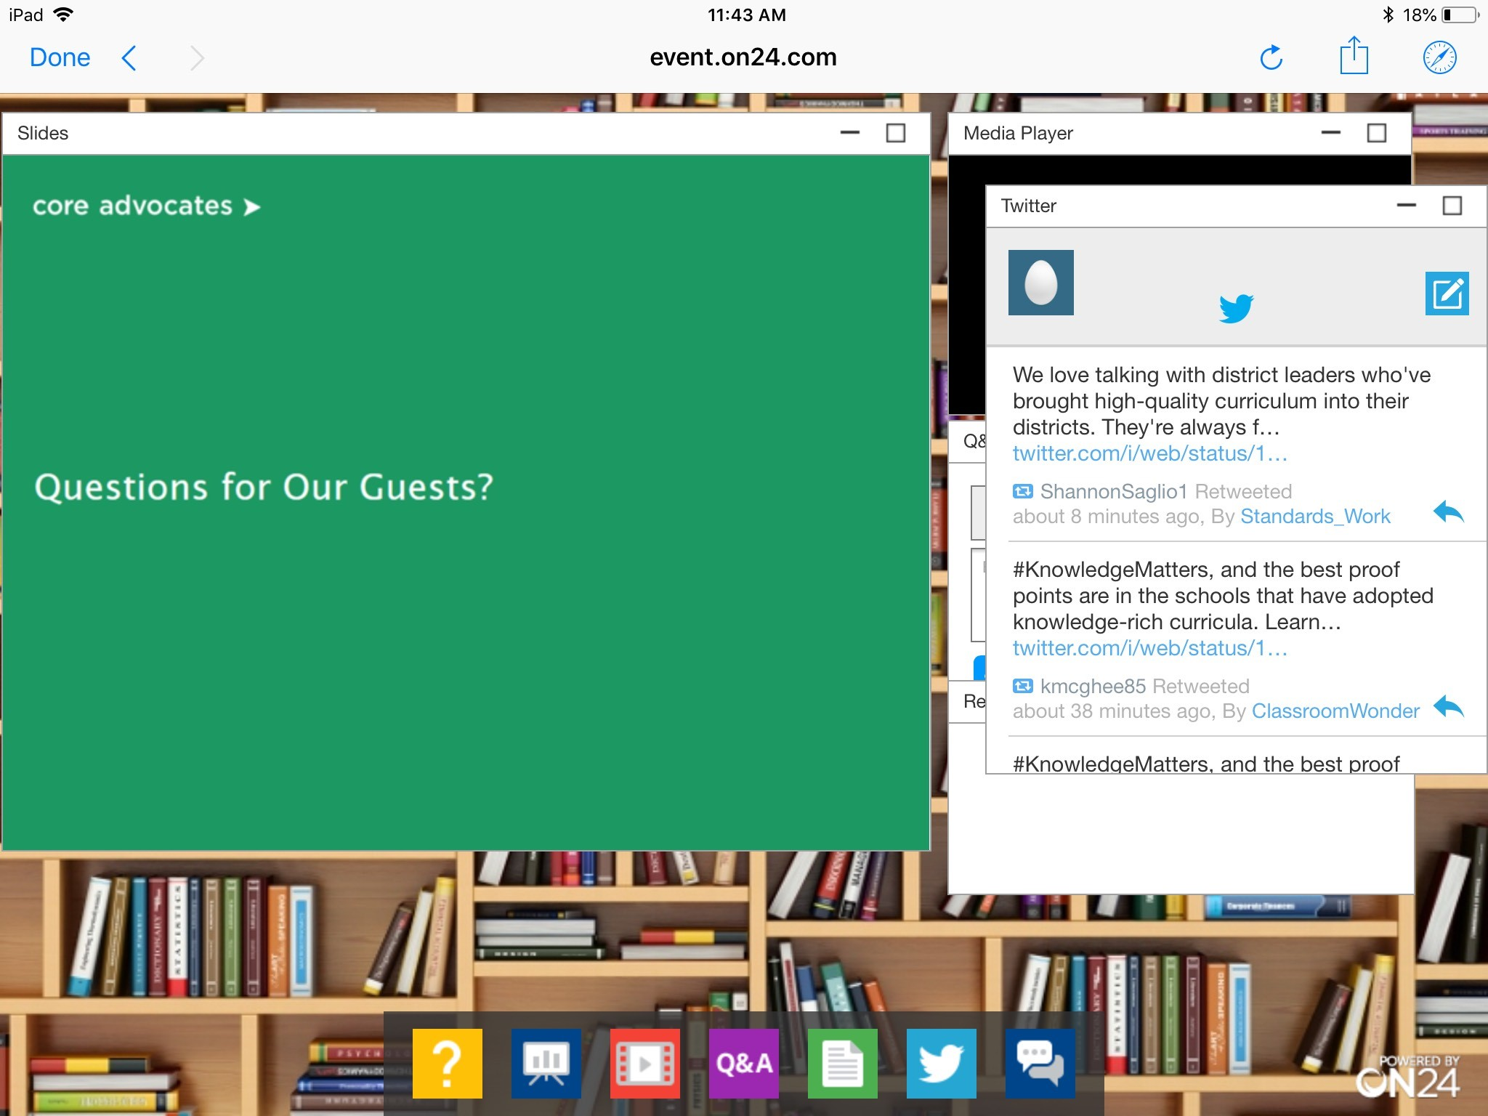
Tweet with Us!
Please feel free to tweet during and after the webinar using #coreadvocates.
@achievethecore
@drbdrost
@yomistere
Click here!

Slide 6
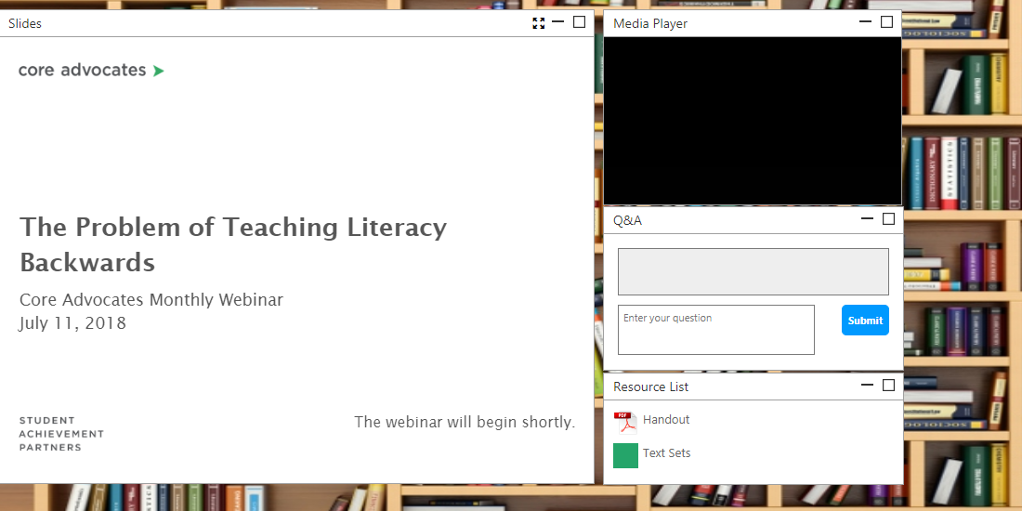
Engage with Us!
During the webinar
– Questions option
– Group chat
– Resources tab
After the webinar
– Access to recording will be emailed to you.
Take our survey in 2 weeks and receive a certificate verifying 1 hour of professional learning.

Slide 7
Goals of the Webinar
Learn the features of a strong formative assessment process as it applies to ELA
Understand that formative assessment is an ongoing process--it’s much more than formal assessment
Identify the different types of data/feedback you’ll get from a multi-faceted formative assessment process in ELA
Discuss ways to use formative assessment data to design effective ELA instruction and enhance equity in the classroom

Slide 8
What words come to mind when you hear the word assessment?
Answer in the Group Chat

Slide 9
Section 1: What is formative assessment? What role does it play in an assessment system and in instruction?

Slide 10
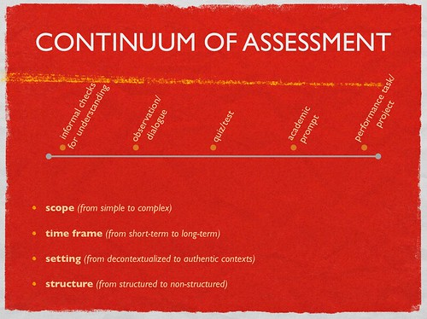
Situating Formative Assessment in the Assessment Spectrum
Assessment comes from the term “assidire,” to sit beside the learner. Assessment is the collecting of information; evaluation is when we put a mark on it.
Assessment exists on a continuum.
Diagnostic
Formative
Summative

Slide 11
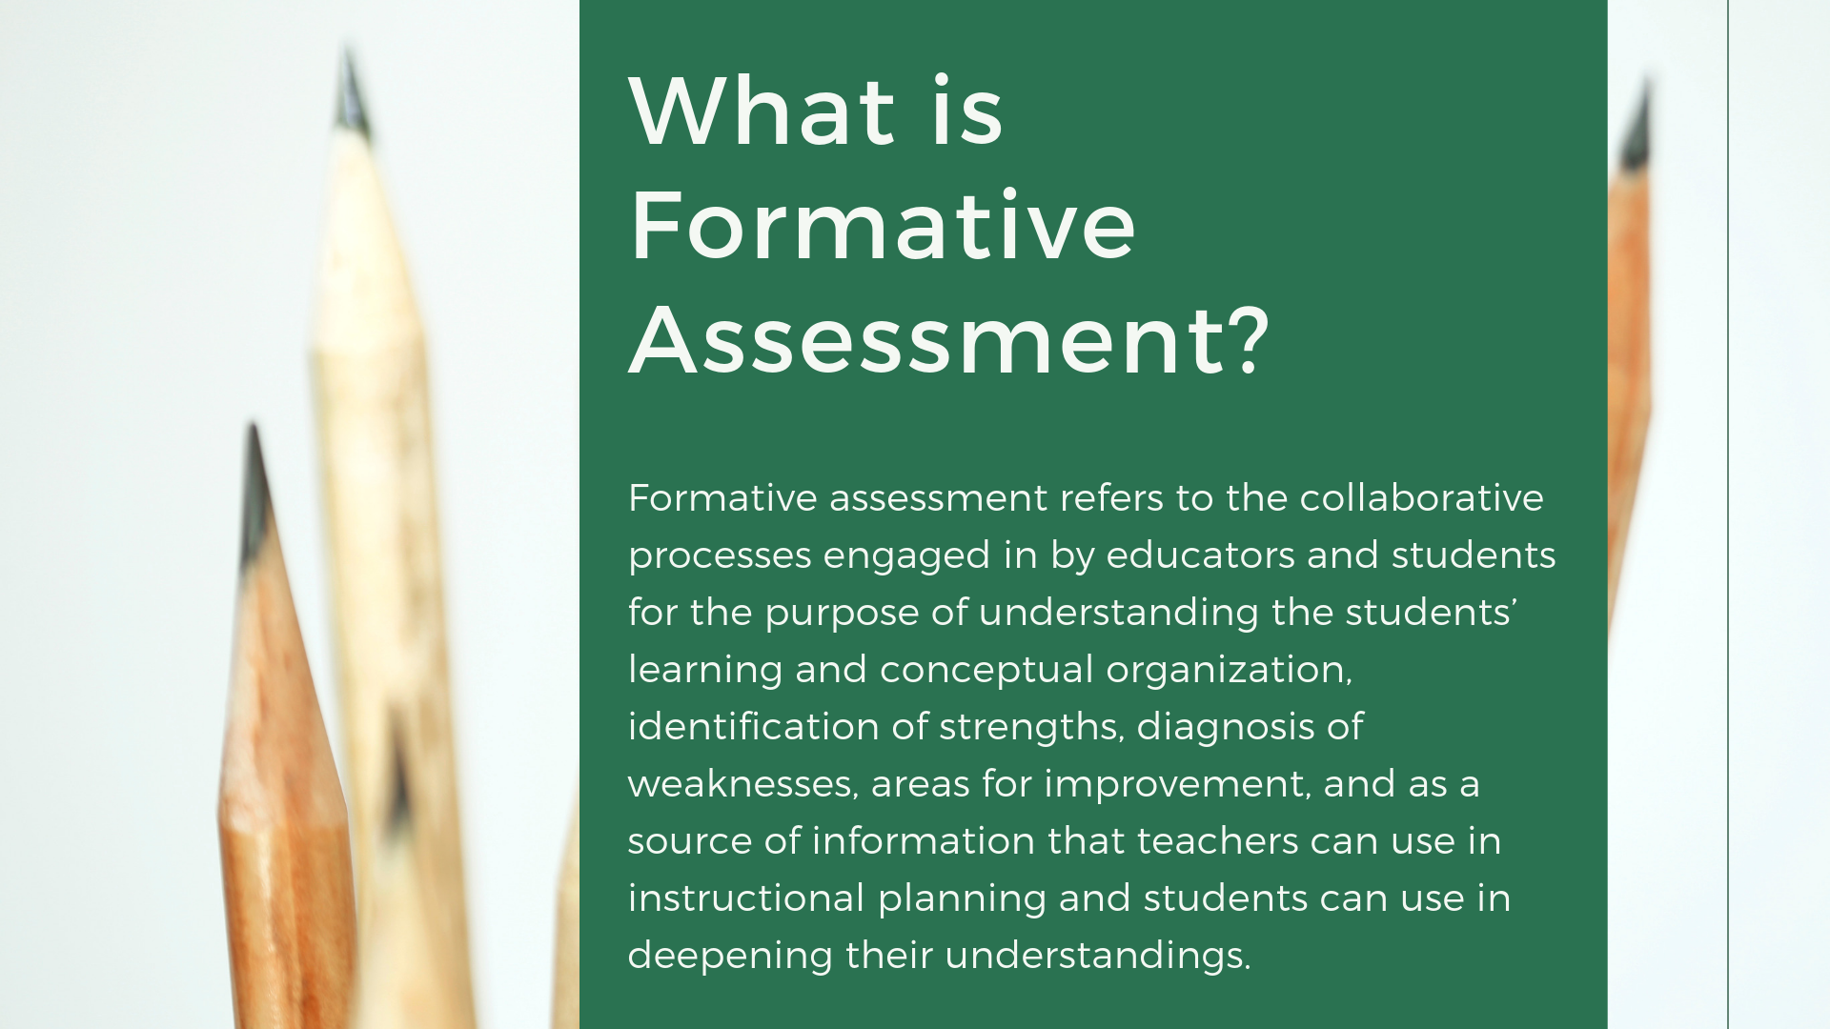
What is Formative Assessment?
Formative assessment refers to the collaborative processes engaged in by educators and students for the purpose of understanding the students’ learning and conceptual organization, identification of strengths, diagnosis of weaknesses, areas for improvement, and as a source of information that teachers can use in instructional planning and students can use in deepening their understandings.

Slide 12
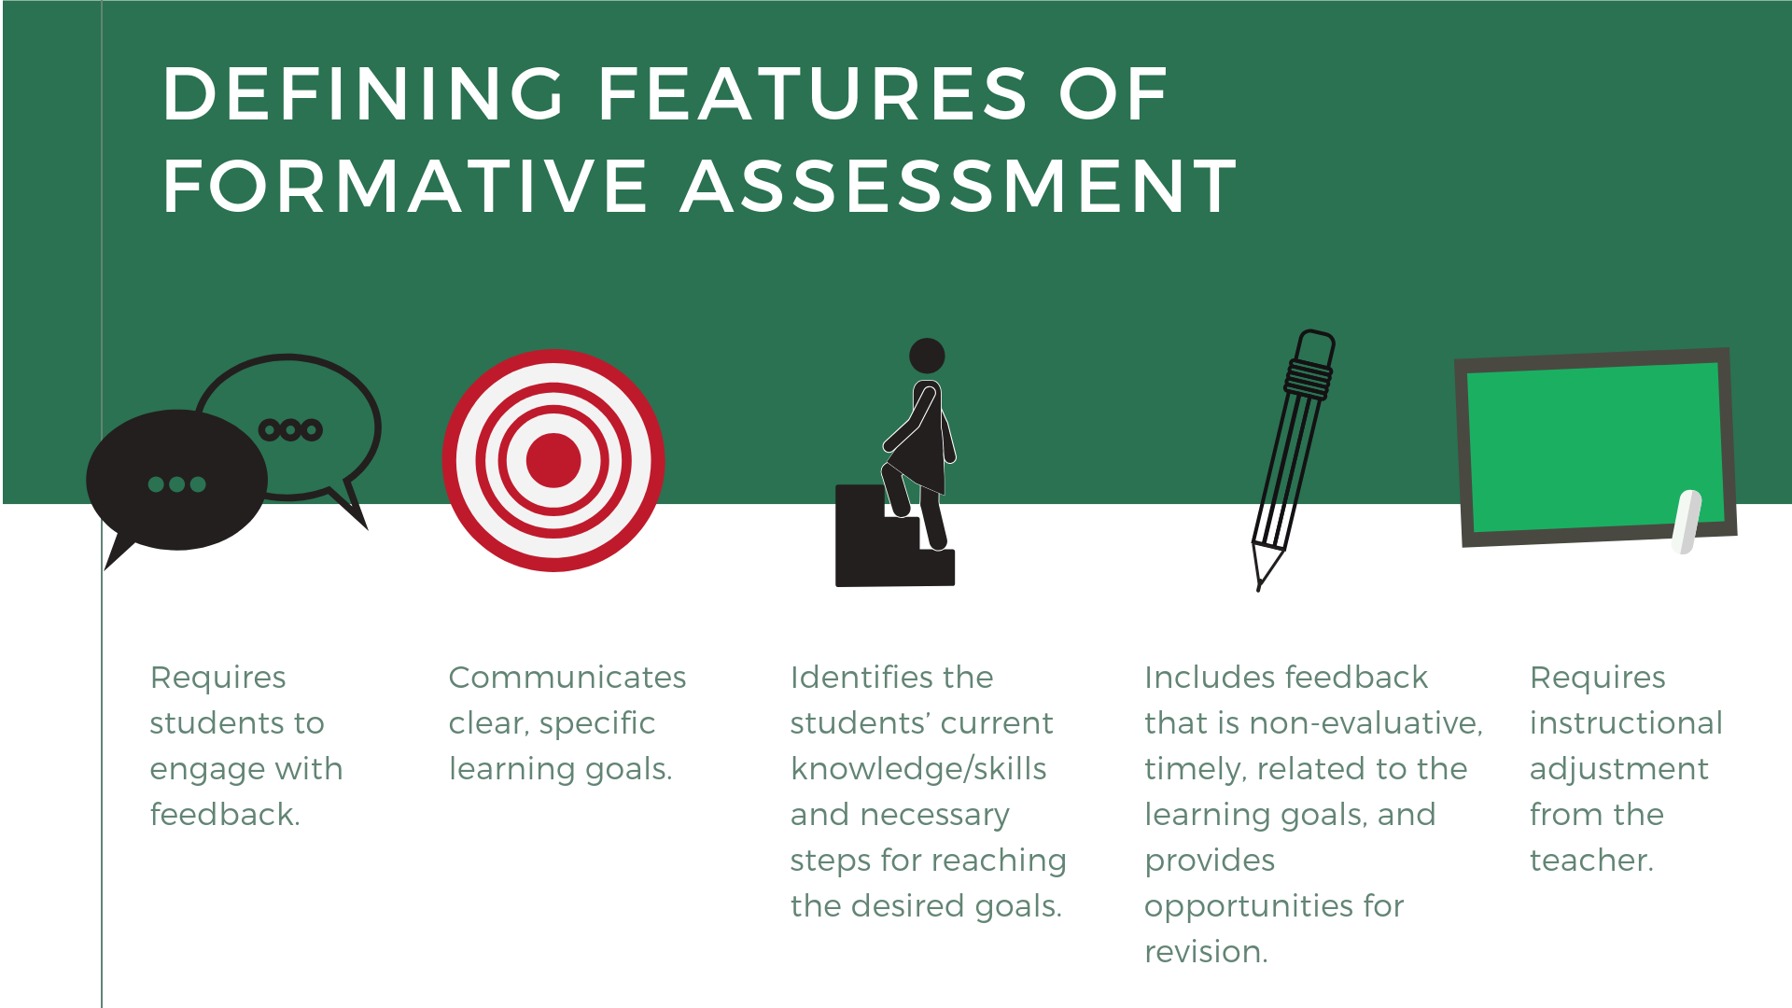
Defining Features of Formative Assessment
Requires students to engage with feedback.
Communicates clear, specific learning goals.
Identifies the students’ current knowledge/skills and necessary steps for reaching the desired goals.
Includes feedback that is non-evaluative, timely, related to the learning goals, and provides opportunities for revision.
Requires instructional adjustment from the teacher.

Slide 13
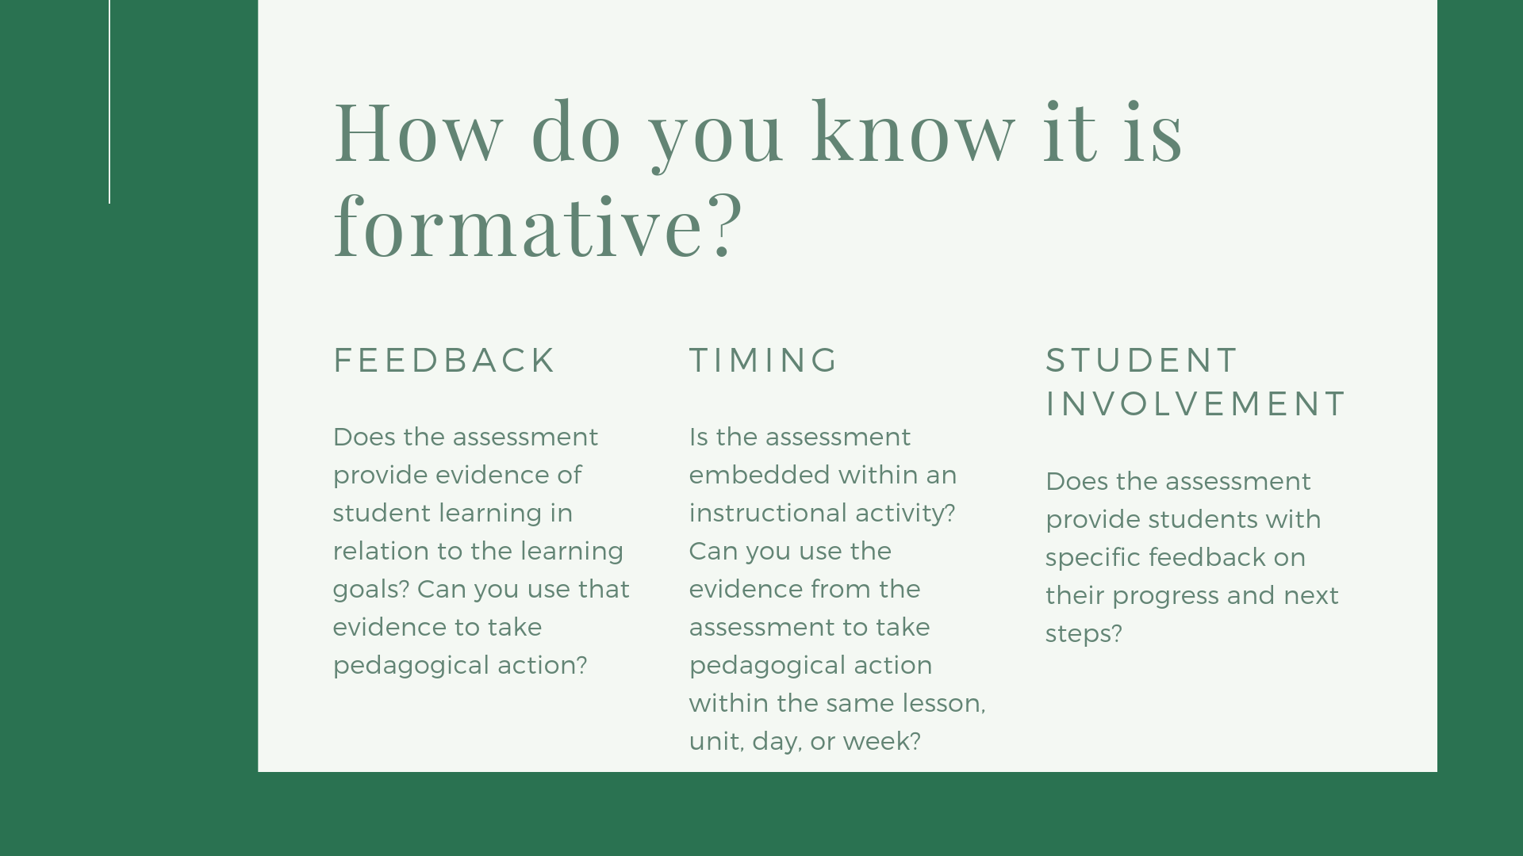
How do you know it is formative?
Feedback: Does the assessment provide evidence of student learning in relation to the learning goals? Can you use that evidence to take pedagogical action?
Timing: Is the assessment embedded within an instructional activity? Can you use the evidence from the assessment to take pedagogical action within the same lesson, unit, day, or week?
Student involvement: Does the assessment provide students with specific feedback on their progress and next steps?

Slide 14
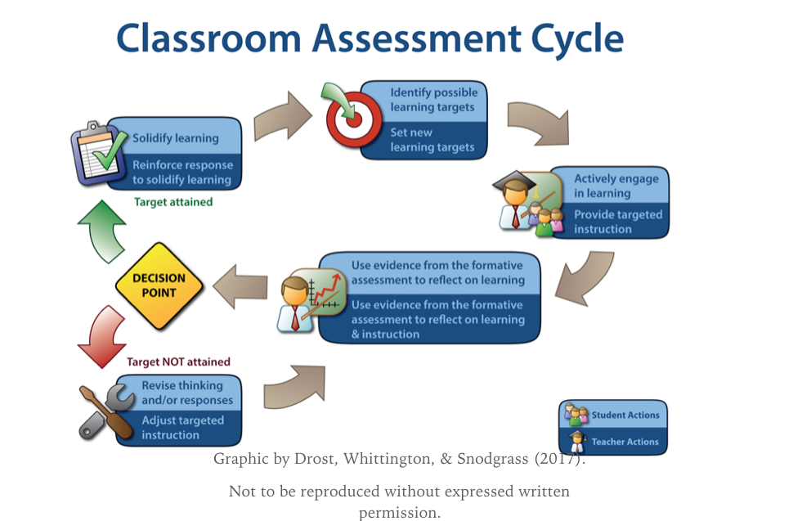

Slide 15
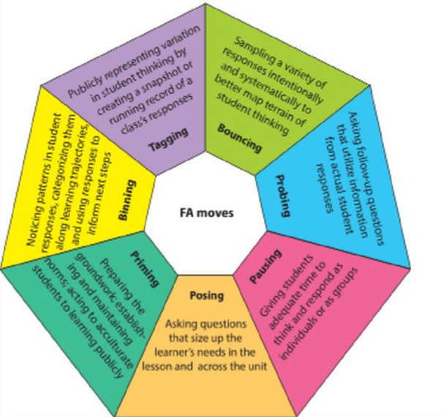
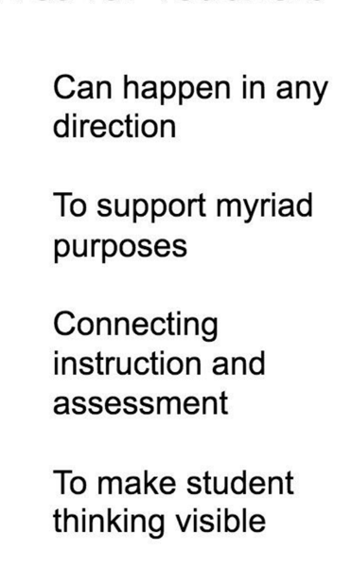
What does the teacher do in formative assessment?
Graphic shared by Duckor & Holmberg, 2017

Slide 16
One of the hallmarks of formative assessment is giving feedback. What strategies do you use to provide actionable feedback to students?
Answer in the Group Chat

Slide 17
Section 2: The Formative Assessment Process

Slide 18

Formative Assessment
Process
Where am I going?
Where am I now?
Where to next?
Schools that use formative assessment show not only general gains in academic achievement, but also particularly high gains for previously underachieving students. Attendance and retention of learning are also improved, as well as the quality of students’ work.
Center for Educational Research and Innovation
Formative Assessment: Improving Learning in Secondary Classrooms
Notes:
The achievement gains associated with formative assessment have been described as “among the largest ever reported for educational interventions”.
The study carried out by the OECD’s Centre for Educational Research and Innovation (CERI) supports these findings. Formative assessment also improves equity of student outcomes. Schools which use formative assessment show not only general gains in academic achievement, but also particularly high gains for previously underachieving students. Attendance and retention of learning are also improved, as well as the quality of students’ work. (Source- Formative Assessment: Improving Learning in Secondary Classrooms by OECD) but there are many others. This article has a nice summary of the most commonly cited sources we use: https://www.gettingsmart.com/2018/07/the-research-base-for-formative-assessment/

Slide 19
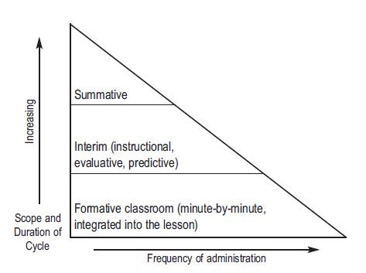
Formative Assessment
Key Takeaways
Formative assessment
is a process
is part of instruction
provides real-time information for teachers and students to adjust instruction and learning
provides students with specific, evidence-based feedback from the teacher
Notes:
Big Idea: The main message on formative assessment is that it is a process, occurring during instruction, and the purpose is to provide information to the teacher and students to adjust instruction and learning.
Details:
Formative assessment practices can take many forms to fulfil the purpose.
Formative assessment could be the questions that a teacher poses to the whole class, small groups for discussion, or individual students to better understand how students are thinking about the content of the lesson in order to adjust instruction to help students meet the learning objectives.
Formative assessment could be a problem set or writing prompt (ungraded) the teacher gives to see what students are retaining and adjust planning for an upcoming lesson.
While there can be many ways to assess formatively, it is important to remember that the purpose is for teachers and students to improve the learning process. Feedback to students should be specific, evidenced-based, and connected to the learning objectives/instructional outcomes for the lesson. Therefore, any data gathered is for that individual classroom use only.

Slide 20
Formative Assessment
Examples
Reading/Writing
Annotations/Notes/Thought Catchers
Comprehension and TD Questions answered in writing
Quick Writes/Summaries
Exit Slips/Questionnaires
Self-Assessment and Procedural Checklists
Listening/Speaking
Non Verbal Communication (Hand signals/Whiteboards/ Online Polls)
Restating
Discussion Protocols
Accountable Talk in small groups
Comprehension and TD Questions answered via discussion
Notes:
Big Idea: As this is a process occurring during instruction, here are some in the moment examples that provide information to the teacher and students to adjust instruction and learning.
Details:
Formative assessment practices can take many forms as checks for understanding.
These can occur in the domains of reading, writing, speaking, and listening
While there can be many ways to assess formatively, it is important to remember that the purpose is for teachers and students to improve the learning process. Feedback to students should be specific, evidenced-based, and connected to the learning objectives/instructional outcomes for the lesson. Therefore, any data gathered is for that individual classroom use only.

Slide 21
Formative Assessment
Some Digital Tools
Padlet
Allows you to make comments, embed photos, videos, etc.
http://padlet.com/drostbr/fa
Today’s Meet
Allows you to create a room for back channeling a discussion
https://todaysmeet.com
Recap
A video-based tool that allows you to pose a question, have students respond with a short video they've recorded on their cell phone, then provide them with feedback.
https://app.letsrecap.com
Notes:
Big Idea: As this is a process occurring during instruction, here are some in the moment examples that provide information to the teacher and students to adjust instruction and learning.
Details:
Formative assessment practices can take many forms as checks for understanding.
These can occur in the domains of reading, writing, speaking, and listening
While there can be many ways to assess formatively, it is important to remember that the purpose is for teachers and students to improve the learning process. Feedback to students should be specific, evidenced-based, and connected to the learning objectives/instructional outcomes for the lesson. Therefore, any data gathered is for that individual classroom use only.

Slide 22

FA: Empowering Educators as Diagnosticians!
Notes:
Big idea: All educators should be empowered to be diagnosticians in their own setting!
Notes:
We don’t want to take this power away from teachers (e.g., wait for the results of our interim assessments to act)

Slide 23
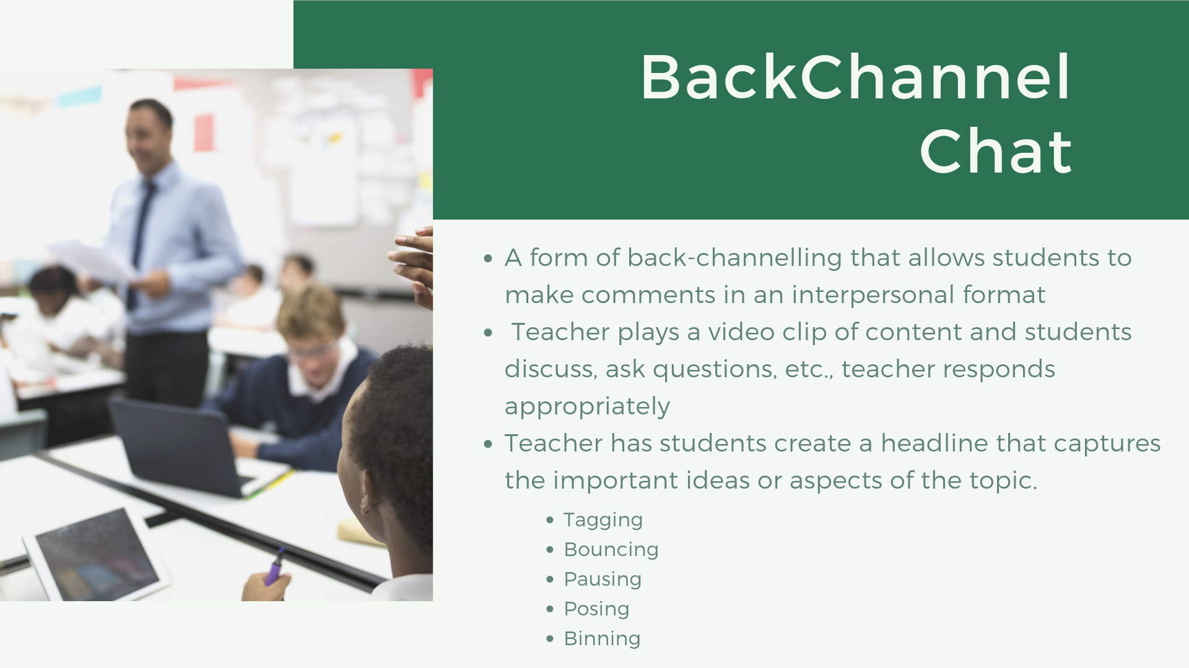
Bryan (3 minutes) (optional)
BackChannel Chat
A form of back-channelling that allows students to make comments in an interpersonal format
Teacher plays a video clip of content and students discuss, ask questions, etc; teacher responds appropriately
Teacher has students create a headline that captures the important ideas or aspects of the topic.
  Tagging,
  Bouncing,
  Pausing,
  Posing
  Binning

Slide 24
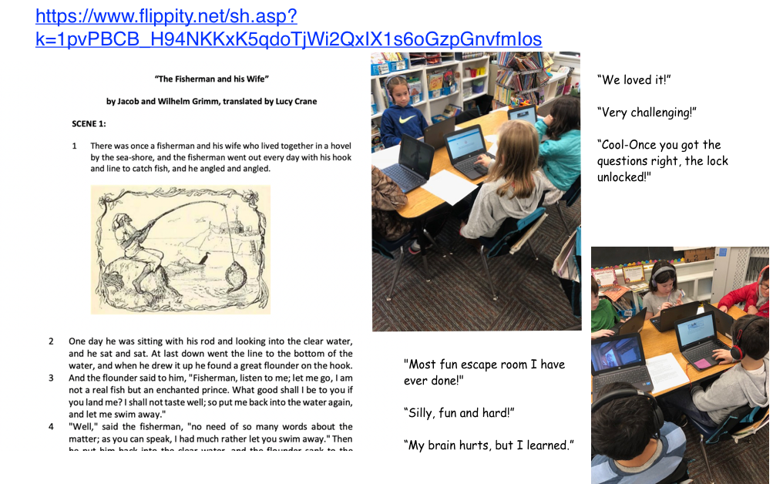
Third Graders Formatively Grappling with Complex Text

Slide 25
Section 3:Designing for Meaningful Evaluation

Slide 26
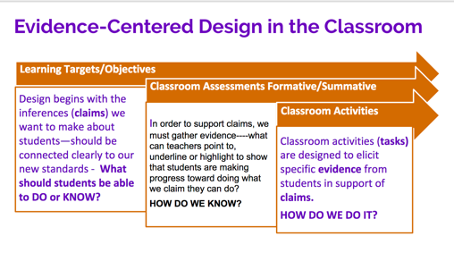
Designing High-Quality Questions

Slide 27
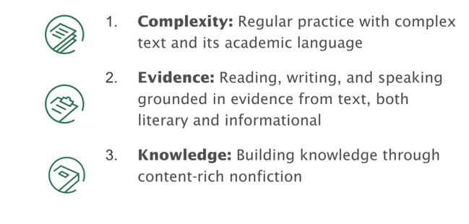
Three Shifts in ELA

Slide 28
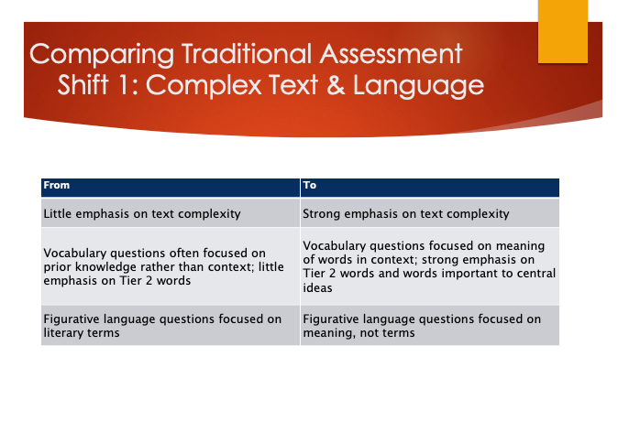

Slide 29
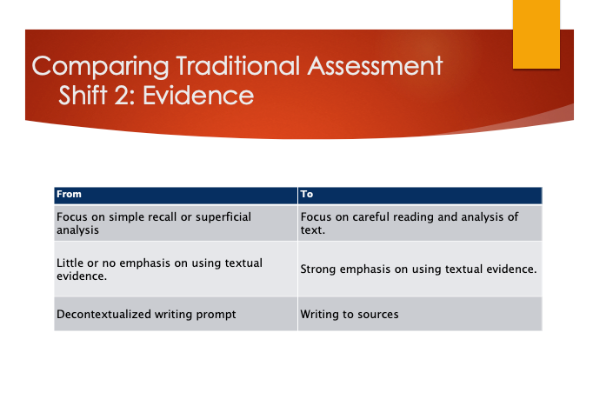

Slide 30
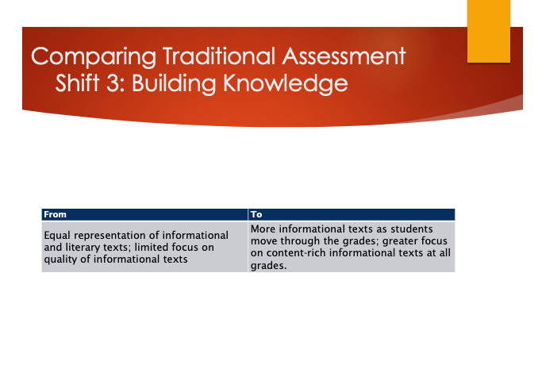

Slide 31
Building Better ELA Assessments
Step 1: Identify the theme of the unit and essential question.
Step 2 Choose at least two passages that follow the guidelines for text complexity; these passages should be cold reads; the goal of our standards and instruction is to prepare students for transfer of skills, not recall or analysis of particular story, novel, text
Step 3: Organize the text: which text will give students requisite background knowledge to help students process the other text – this text should be first
Step 4: Write one overarching writing question that connects both passages and texts read within the unit; the question should require students to synthesize the two texts as well as use knowledge gained within the unit*
Step 5: Write 3-4 questions for each passage; Write questions that get to the depth of the standard; vary the depth
Step 6: Write 3-4 questions that require students to analyze, evaluate both passages together
Step 7: Review all questions using the three-step check
- Do all questions use academic vocabulary?
- Do all questions require students to use (not collect) evidence from the text?
- Do all questions lead students to make sense of the text, areas where students tend to have difficulty so that they are building knowledge?
Notes:
*Note that SAP strongly advocates crafting the WRITING PROMPT first that will tie the unit together. Then, the other questions written should scaffold student learning to enable them to answer the prompt.

Slide 32
Evaluating Formative Assessment

Slide 33
Evaluating Formative Assessment
Feedback: Does the assessment provide evidence of student learning in relation to the learning goals? Can you use that evidence to take pedagogical action?
Timing: Is the assessment embedded within an instructional activity? Can you use the evidence from the assessment to take pedagogical action within the same lesson, day, or week?
Student involvement: Does the assessment provide students with specific feedback on their progress and next steps?
Reflect on these questions in relation to your own formative assessment process (or for the educators you support).
Notes:
Describe various ways to evaluate formative assessment
Introduce questions as guiding questions to frame your understanding and use of formative assessments.
Feedback from the assessment should be directly related to the specific content and skills explicitly taught within the lesson/unit, not relying on other funds of knowledge or cultural experiences.
Timing should be in the moment and connected to instructional activity which differs from interim or summative assessment tasks.
Students should be receive feedback in time to correct/remediate close to the skill/content being taught.

Slide 34

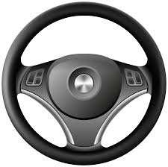
Connection to Student Thinking
Seeing and hearing student thinking is the best type of data to drive instruction!
Notes:
Big Idea: Being able to see/hear student thinking (vs. an answer that requires speculation about what the student might know and not know) is the best type of data that will drive instruction.
Doesn’t have to be fancy! It can include simple approaches like:
Developing an awareness of students’ prior experiences and knowledge, including reading experiences, to help tie to texts under study and highlight areas that need further exploration. (In other words, it doesn’t have to always be skills based.) For example, learning that students have not read sci-fi before would lead teachers to some understanding of things they need to focus on as a subgenre.
Having students think aloud as they read.

Slide 35
Use of Data Concerns
Assessment Type | Summative | Interim | Formative Practices
Common Concern | Data doesn’t come back soon enough to support students. | Data is not specific enough; should be at the standard level. | Data doesn’t come from this level.
Response | Data isn’t intended to support students | Standard-level data doesn’t reflect best practices for literacy | This is the best data to use to inform teacher understanding and decisions about students
What would your response to these common concerns be?
Notes:
We often hear many concerns about data. (Introduce 3 common concerns on the screen.)
Solidifying previous learning on assessment literacy - what do we use the data for? How can we address common concerns re: assessment

Slide 36
Use of Data Concerns
Assessment Type | Summative | Interim | Formative Practices
Common Concern | Data doesn’t come back soon enough to support students. | Data is not specific enough; should be at the standard level. | Data doesn’t come from this level.
Response | Data supports comprehensive reflection on teaching to adjust in the future. | Standard-level data doesn’t reflect best practices for literacy. | This is the best data to use to inform teacher understanding and decisions about students.
Notes:
For interim, tests tend to be shorter so data would be questionable. Also, what would you do if you did get data by standard? Drill down and only teach one standard, right? That has proven to be an ineffective method of instruction and actually takes away the idea of how the standards are interwoven. For example, in a literary text, what if you just focused on character development, standard 3. It’s great to understand the characters but superficial if you don’t relate those characters to the theme or main idea of the text. Honing in on one standard runs the risk of not allowing students to fully comprehend the text.

Slide 37
Other Assessment Concerns
Equity
Some assessments (summative and interim in particular) may be subject to cultural bias(es) in that they test knowledge that is neither directly nor explicitly related to classroom instruction of skills or content
  Race/Ethnicity
  Socioeconomic status and lived experiences
  Literacy
Instructional Time
While tests are valuable, each test takes time and resources that could be used for other activities in the school day.
Formative assessment addresses these concerns by ensuring that each assessment is used for an important instructional purpose and leads to actions intended to improve student learning.
Notes:
Name concerns about misuse of assessment data and poor assessment design that could lead to inequitable instruction for students

Slide 38
Using Formative Data to Inform Instruction
Analysis of Student Work
Student homework, assessments, and class notes provide info on:
  Student's current knowledge, attitudes, and skills about subject matter
  Strengths, weaknesses, and learning styles
  Need for further, or special, assistance
Analysis of Student Discussion
Teachers move around the classroom and listen to various discussions, gaining insight into an individual’s levels of understanding.
Based on student discussion, teachers can remediate whole class or small group, can address common mistakes or misconceptions, or can highlight exemplar models.
Admit/Exit Tickets/Summaries
Teachers review responses, gaining insight on which students have fully learned the concept, and those that are still struggling.
Notes:
The information obtained can be used to plan a whole-group or partial-group lesson to re-teach the concept.

Slide 39

Racism and inequity are products of design.
They can be redesigned.
We are all designers.
Notes:
That’s a hopeful sentence because if they’re products of design that means they can be redesigned

Slide 40

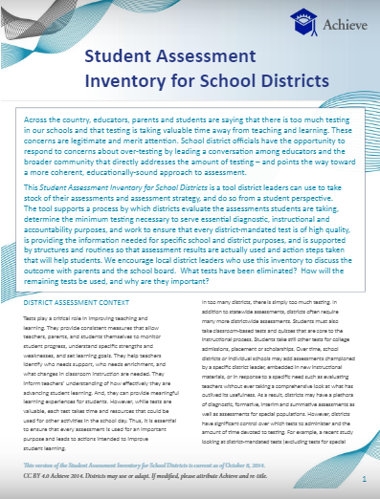
“While tests are valuable, each test takes time and resources that could be used for other activities in the school day. Thus, it is essential to ensure that every assessment is used for an important purpose and leads to actions intended to improve student learning.”
Consider: What does this bring up for you?
Notes:
That’s a hopeful sentence because if they’re products of design that means they can be redesigned

Slide 41
Don’t Forget to Monitor Fluency
  Just a little research supports its importance for comprehension
    (Chard, Vaughn, & Tyler, 2002; Fuchs, Fuchs, & Maxwell, 1988; Fuchs, Fuchs, Hops, & Jenkins, 2001; Jenkins, Fuchs, van den Broek, Espino, & Deon, 2000, 2003; NAEP, 2002; Torgesen & Hudson, 2006)
Hundreds More
The work of Tim Rasinski
Makes sense

Slide 42
What Texts to Use to Monitor Fluency
Grade Level (Paige, 2006, 2011; Stahl & Heuback, 2005; Young & Bowers, 1995)
Use texts being studied in the classroom!

Slide 43
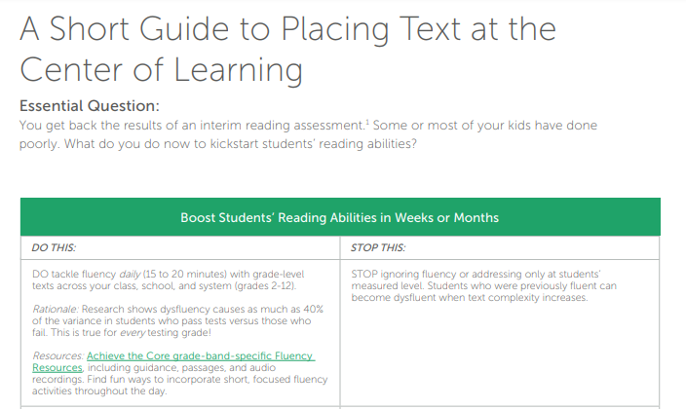
So What Should We Do With Information Gleaned from the Formative Assessment Process?
There’s a resource that helps answer this question.
A Short Guide to Placing Text at the Center of Learning
It offers guidance on what to do with those interim assessment results, and more important what NOT to do.
bitly.com/text-at-the-center
Notes:
Here’s what you do with the data?
Not every piece of this is specific to assessment but will see some connections to high quality instructional materials session and the instructional practices session.
Activity for participants: Read the guide. After doing so, reflect on what you might think about differently now having read the recommendations. If you’re a teacher, how does this change your instruction? If you are a coach or leader, how might you advise those you lead given these recommendations?

Slide 44
Questions for Our Guests?

Slide 45
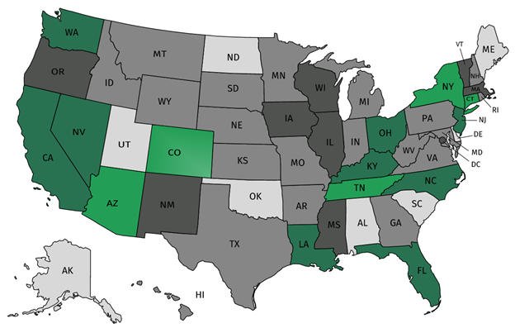
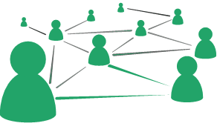



Join our network!
Join a national network of educators
Connect with state networks
Be a part of creating new tools and resources in partnership with SAP
Keep up to date on free resources, upcoming SAP webinars/professional learning opportunities, job postings and more!
Notes:
If you found tonight’s webinar helpful, we’d like to invite you to join our Core Advocate network! We’re committed to solving real problems that real teachers have and we know the best way to do this is to know more about what folks are experiencing.
As part of our national network, you have opportunities to connect with educators across the country, maybe even the network in your state! You can keep up to date on tools and resources available on Achieve the Core, as well as a variety of virtual learning opportunities and other ways to engage with us. We also work with educators in our network to help us build tools and resources.
We’d love to learn about who you are, where you work, the types of things you’re interested in and the expertise you already have. This way, we will be able to tailor our webinars and other opportunities to your needs and interests (we may even tap you to be our next webinar panelist).

Slide 46




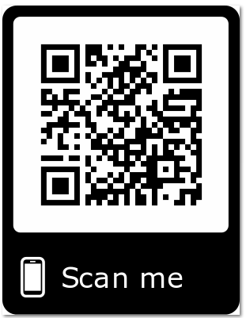
Please Join Us!
https://achievethecore.org/ca-signup
Twitter: twitter.com/achievethecore
Facebook: facebook.com/achievethecore
Pinterest: pinterest.com/achievethecore
Notes:
We encourage you to join the network by filling out this survey completely at atc.org/ca-signup

Slide 47
Please Join Us Again Next Month!
Next month’s webinar:
Mathematical Language Routines: Vibrant Discussions in the Math Classroom
Register Here: https://event.on24.com/wcc/r/2069823/5E755C8DE93E1F1E69562070FBC3C775

Slide 48
Thank You!

